Slide 1
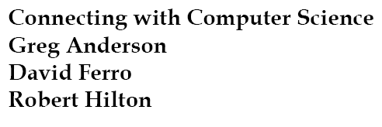
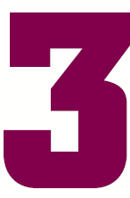
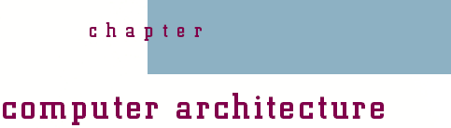

Slide 2
Objectives
Learn why you need to understand how computers work
Learn what a CPU is, and what it is made of
Learn how digital logic circuits are constructed
Learn the basic Boolean operators
Understand how the basic logic gates operate and are used to build complex computer circuits

Slide 3
Objectives (continued)
Learn the importance of von Neumann architecture
Understand how the computer uses memory
Learn what a system bus is and what its purpose is
Understand the difference between memory and storage

Slide 4
Objectives (continued)
Be able to describe basic input/output devices
Understand how a computer uses interrupts and polling

Slide 5
Why You Need to Know About...
Computer Architecture
Computer: hardware designed to run software
  Purpose: accomplish desired tasks
Professional’s need: understand logical connection between hardware and software
Computer architecture: organization of hardware components into a computer system

Slide 6
Inside the Box
Computer system: an external view
  Monitor
  Keyboard and mouse
  Computer case
CPU (central processing unit)
  Resides in case on main board or motherboard
  Computational center served by all other parts
  Touch point for the study of computer architecture

Slide 7
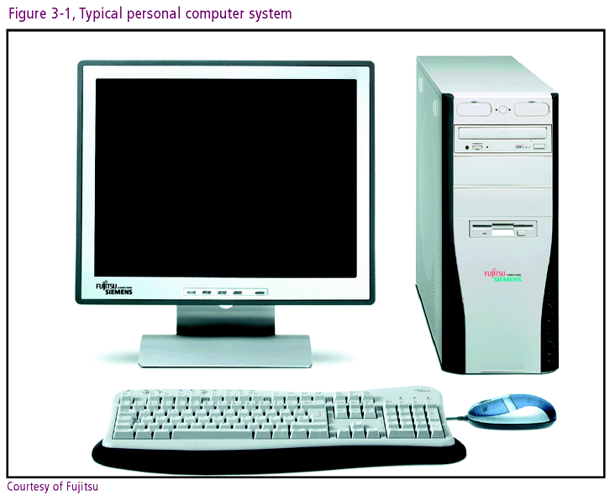

Slide 8
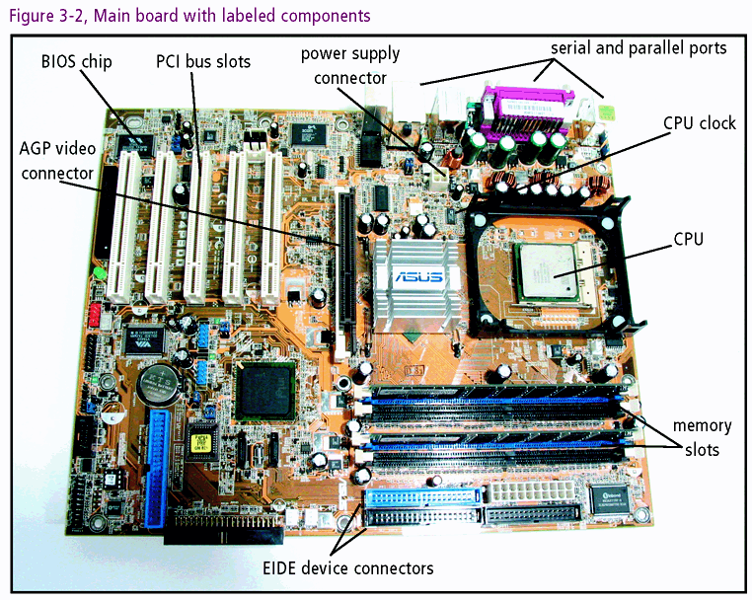

Slide 9
The CPU
The CPU is the computer
  Contains digital components that do processing
  Fundamental component: transistor
Transistor
  Electronic switch accommodates binary values
  Millions of transistors per chip
  Organized into a higher level called a circuit

Slide 10
The CPU (continued)
Four basic functions: Adding, Decoding, Shifting, Storing
Four corresponding transistor circuits
  Adder: adds, subtracts, multiplies, divides
  Decoder: reacts to specific bit patterns
  Shifter: moves bits to right or left
  Flip-flops (latches): used to store memory bits

Slide 11
How Transistors Work
Material composition: silicon or germanium
Logically organized into three parts: emitter, collector, and base
Transistor as electronic switch
  Base used to turn current on and off
  Capacity to control current translates into capacity to manipulate binary values of 1 and 0
Size considerations: Typical transistor 130 nanometers wide (Pentium IV)

Slide 12
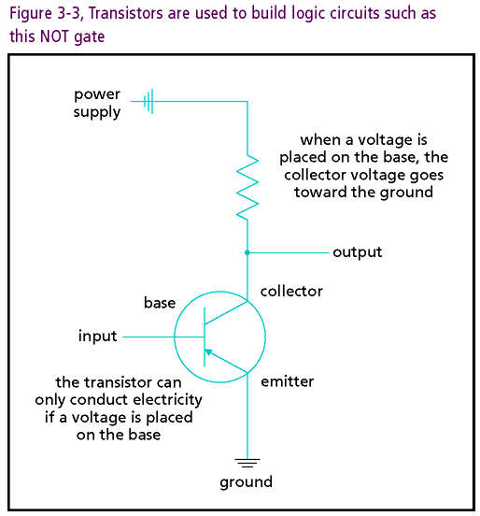

Slide 13
Digital Logic Circuits
Logic circuit
  Next level of organization above transistor
  Leverages switching function of transistor
  Performs operations of Boolean algebra
Boolean algebra
  Functions relating binary input and output
  Chief operators: AND, OR, NOT
  Boolean variables are true (1) or false (0)
  Boolean expressions use Boolean operators and variables

Slide 14
Digital Logic Circuits (continued)
Truth tables
  Convenient tabular representations of Boolean expressions
  Column(s) represent inputs and output(s)
  Rows correspond to each possible combination of inputs
    2^{n} rows needed for n inputs (n is positive integer)
    Example: two inputs require 2 ² = 4 rows

Slide 15
The Basic Boolean Operators
Three Basic Operators: AND, OR, NOT
AND operator
  Takes two values as input (x and y) and generates one output (z)
  Both inputs must be true (1) for output to be true (1)
    When x = 1 and y = 1, z = 1
  Any other combination yields output of false (0)
  Equivalent Boolean Expression: xy = z

Slide 16
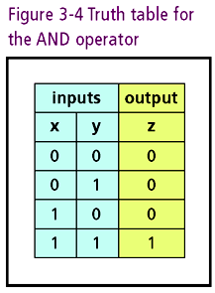

Slide 17
The Basic Boolean Operators (continued)
OR operator
  Takes two values as input (x and y) and generates one output (z)
  Either input valued true (1) will cause output to be valued true (1)
  When both inputs are valued false (0), output will be valued false (0)
  Equivalent Boolean expression: x + y = z

Slide 18
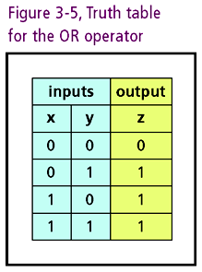

Slide 19
The Basic Boolean Operators (continued)
NOT operator
  Takes one value as input (x) and generates one output (z)
  Reverses value of input.
    When x = 1, z = 0
    When x = 0, z = 1
  Equivalent Boolean expression: x′ = z or x = z

Slide 20
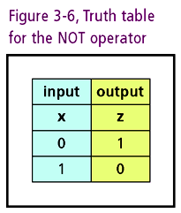

Slide 21
Digital Building Blocks
Circuit Hierarchy
  Gates: transistor circuits implement Boolean operators
  Gates grouped into more complex circuits that carry out computer tasks
Reliability
  Binary values maintained with consistent voltage levels
  Output of gates completely determined by input
Six fundamental gates
  AND, OR, NOT (primitive or basic)
  NAND, NOR, XOR (constructed from AND, OR, NOT)

Slide 22
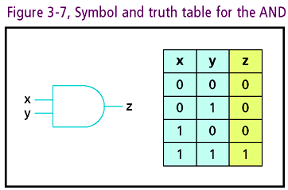
Digital Building Blocks (continued)
AND gate
  Allows for two inputs and has one output
  Truth table identical to that of AND Boolean Operator

Slide 23
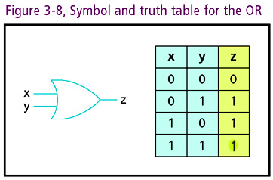
Digital Building Blocks (continued)
OR gate
  Allows for two inputs and has one output
  Truth table identical to that of Boolean OR

Slide 24
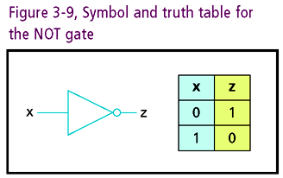
Digital Building Blocks (continued)
NOT gate
  Allows for one input and one output
  Truth table identical to Boolean NOT

Slide 25
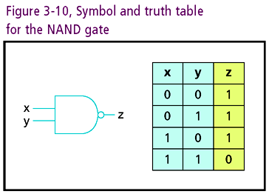
Digital Building Blocks (continued)
NAND gate
  Reverses output of AND gate with NOT gate
  Output opposite that of AND gate

Slide 26
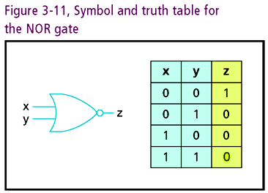
Digital Building Blocks (continued)
NOR gate
  Reverses output of OR gate with NOT gate
  Truth table opposite of OR gate truth table

Slide 27
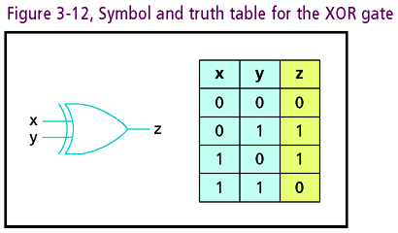
Digital Building Blocks (continued)
XOR gate
  Exclusive OR (one or the other, but not both)
  Inputs with opposite values generate output of 1

Slide 28
Gate Behavior
Predictability of Gates
  Predicated on corresponding truth table
  Output for given input derived from truth table
Scalability
  Complex circuits constructed with basic gates
  Output of one gate is connected as input to another
  Example: 3-input AND gate from two 2-input AND gates

Slide 29
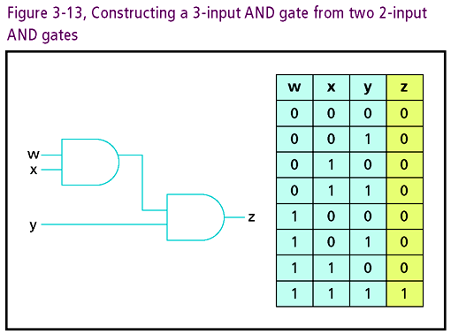

Slide 30
Complex Circuits
Four Fundamental circuits of CPU
  ADDER, DECODER, SHIFTER, FLIP-FLOP
  Constructed from basic gates
ADDER
  Function: adds two binary numbers, outputs result
  Inputs: two bits (x, y) to add and one carry-in (ci)
  Outputs: sum bit (s) and one carry-out bit (co)

Slide 31
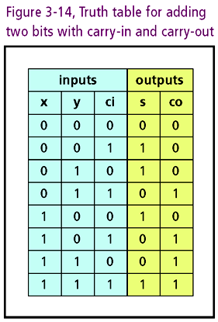

Slide 32
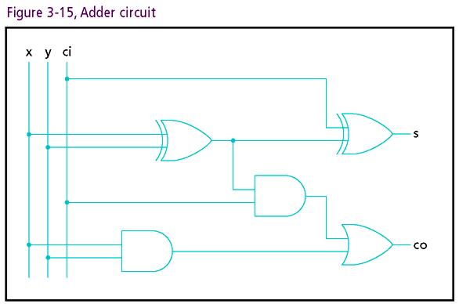

Slide 33
Complex Circuits (continued)
Decoder
  Functions: Address memory, select I/O devices
  Given input pattern, output line selected
  Circuit with n inputs can control 2^{n} lines
    Example: 32 inputs could control 4 billion lines
  Illustrate Decoder with two inputs
    Has four possible outputs
    Truth table incorporates four basic truth tables

Slide 34
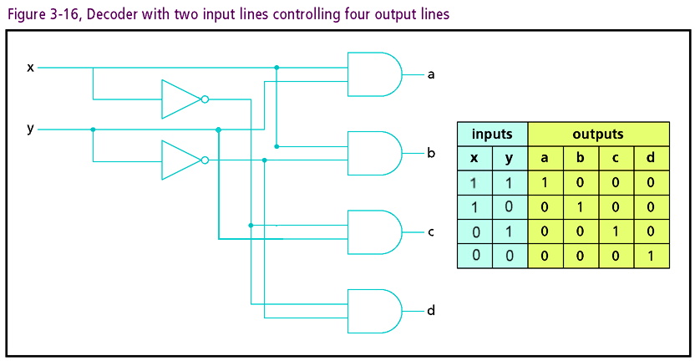

Slide 35
Complex Circuits (continued)
Flip-flop
  Special form of latch circuit
  Function: holds value at output even if input changes
  Inputs: S (set) and R (reset)
  Outputs: Q and Q′
  Ideal for bit storage
    Used for high-speed memory in CPU
    Static RAM, SRAM, cache

Slide 36
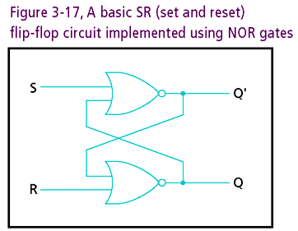

Slide 37
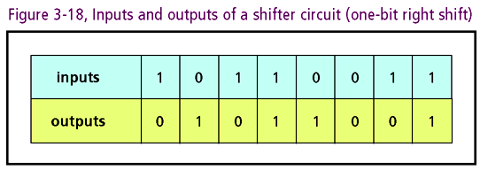
Complex Circuits (continued)
Shifter
  Purpose: support math operations such as multiplication and division
  Function: shifts input bits to the left or right

Slide 38
Complex Circuits (continued)
Other circuits: multiplexer, parity generator, counter
Three part design process
  Construct truth table relating inputs and outputs
  Build Boolean expression equivalent to truth table
  Represent Boolean expression in a circuit diagram

Slide 39
Complex Circuits (continued)
Modern design efforts supported with software
Integrated Circuits (ICs)
  Whole circuits etched onto single semiconductor chip
  VLSI (Very Large-Scale Integration) chip
    Contains millions of transistors making up CPU circuits

Slide 40
Von Neumann Architecture
Multipurpose machine with following characteristics:
  Instruction cycle: Fetch-Decode-Execute
  Instructions and data are stored in main memory
  Instruction execution carried out by central processing unit (CPU)

Slide 41
Von Neumann Architecture (continued)
  CPU consists of:
    Control unit (CU)
    Arithmetic logic unit (ALU)
    Registers (small storage areas).
  The CPU interacts with input and output devices

Slide 42
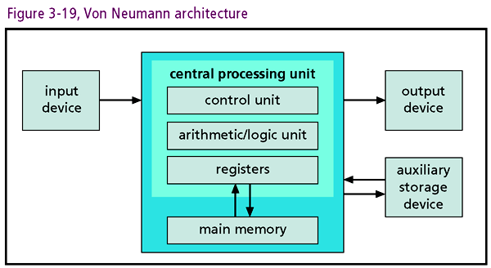

Slide 43
Von Neumann Architecture(continued)
Breakdown of typical fetch-decode-execute cycle:
  Control unit uses the address in program counter register to fetch an instruction from main memory
  Instruction decoded
  Any needed data retrieved from memory and placed into other registers
  ALU executes the instruction using data in registers, if necessary
  Input or output operations required by the instruction are performed

Slide 44
Von Neumann Architecture(continued)
Crystal (system) clock synchronizes steps in instruction sequence
  Computers measured by clock speed
  Example: Pentium IV speed = 3 GHz. Processes 3 billion instruction cycles per second
Trends in clock speed
  Rising for 60 years
  Laws of Physics erected speed barrier at 100 MHz
  Parallelism and caching work around speed limit

Slide 45
Buses
Bus: set of wires and rules facilitating data transfer
Components connected via system bus
Bus wires divided into three separate signal groups:
  Control
  Address
  Data
Modern bus standard: PCI (Peripheral Component Interconnect)

Slide 46
Peripheral Buses
SCSI: Small Computer System Interface
  Connects different types of I/O devices to computer
  Allows CPU to pass control to other devices (bus mastering)

Slide 47
Storage
Storage: family of components used to store programs and data
Storage hierarchy
  Primary memory
  Secondary memory (mass storage)

Slide 48
Memory
Two basic flavors
  ROM (read-only memory)
    Memory etched into chip
    Generally cannot be modified
    BIOS (basic input/output system) in this category
  RAM (random access memory) basics
    Allows direct memory reference
    Allows reading and writing
    Volatile
    CPU fetches program instructions from RAM

Slide 49
Memory (continued)
Types of RAM
  DRAM (Dynamic RAM)
    Made of circuits using one transistor per bit
    Needs to be constantly refreshed to maintain data
    Access speeds ranging from 10 – 70 ns
  SRAM
    Made of flip flop circuits
    Fastest memory type
    Used chiefly in registers and cache

Slide 50
Mass Storage
Secondary memory characteristics
  Greater storage capacity than RAM or ROM
  Used for devices such as hard drive or CD-ROMS
  Cheaper storage per megabyte than RAM or ROM
  Non-volatile
  Slower than RAM or ROM

Slide 51
Mass Storage (continued)
Hard disk drives
  Most common form of mass storage
  Magnetic metal platters store information
    Organized into concentric circles called tracks
    Tracks divided into sectors
    Platters spin at about 7200 RPM
    Read/write heads interface with disk surface
  Low cost-unit storage ratio relative to RAM
  RAID (Redundant Array of Independent Discs)

Slide 52
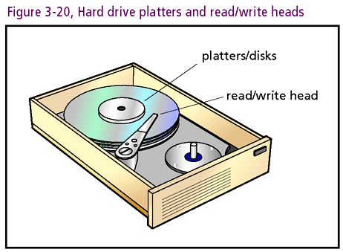

Slide 53
Mass Storage (continued)
Optical Storage
  Popular formats: CDs (compact disks) and DVDs (digital video disks)
  Stores data using optical (laser) technologies
    Pits burned into disks interpreted as binary data
    Data written to disks in continuous spiral
    Like hard disks, CDs and DVDs spin
    Read/write heads interface with disk surface
  Low cost-unit storage ratio

Slide 54
Mass Storage (continued)
Flash (Thumb) drives
  Portable storage that plugs into USB (Universal Serial Bus) port
  Replacing floppy drives
  Uses non-volatile flash memory
  Low cost-unit storage ratio

Slide 55
Input/Output Systems
Final component of Von Neumann architecture
Input/Output (I/O) devices: computer’s connection to user

Slide 56
Input Devices
Keyboard
  Chief input device for most users
  Connected to motherboard through port and then to CPU by controller circuit and system bus
  Keystrokes are translated into binary signals for CPU consumption
Mouse
  Used in conjunction with keyboard
  Senses movement that can be translated into binary code
Other devices: trackballs, styluses, touch pads/screens

Slide 57
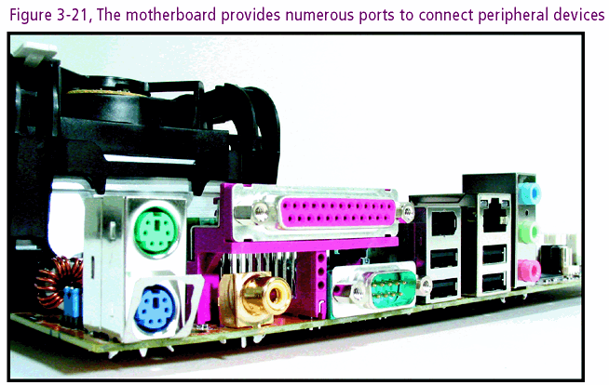

Slide 58
Output Devices
Communication channel to outside world
Monitors
  Primary output device
  CRTs (cathode ray tubes)
    Utilizes raster scanning techniques
    Quality based on resolution and refresh rate
  LCD (Liquid Crystal Display)
    Thinner and cooler than CRTs
    Utilizes transistors rather than electron beams
    Quality based on resolution and refresh rate

Slide 59
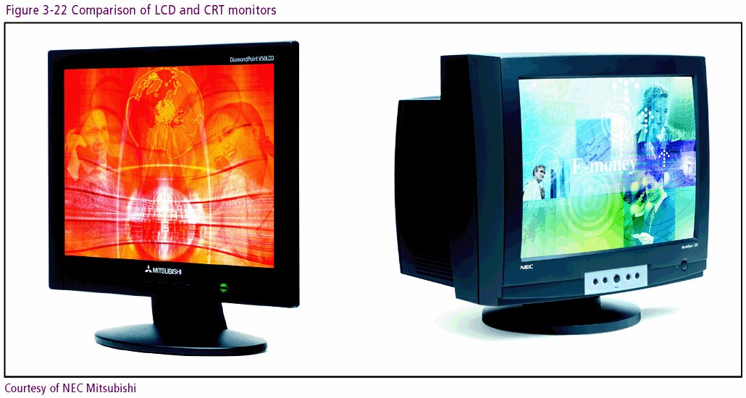

Slide 60
Output Devices (continued)
Printers
  Important output device
  Chief varieties: ink jet and laser printers
  Quality measured by resolution (dots per inch) and speed (pages per minute)
Sound cards
  Fit into PCI expansion slot on main boar
  Used to digitize sound for storage
  Also converts binary sound files into analog sounds

Slide 61
Interrupts and Polling
CPU instruction cycle equals clock speed
CPU commits to cycle based on processing need
Processing need determined by (2) techniques
  Polling: CPU interrogates I/O device
  Interrupt Handling: I/O device initiates request for service

Slide 62
Choosing the Best
Computer Hardware
No one size fits all
Circumstances drive selection process
Some criteria
  Define objectives for machine
  Ascertain metrics such as clock speed, memory type, bus speed, hard drive speed
  Compare models
  Solicit opinions
  Consider price

Slide 63
One Last Thought
All computer scientists need architectural concepts
Advanced hardware studies highly recommended
Stay current on latest industry developments

Slide 64
Summary
Computer architecture: hardware design
Von Neumann architecture: design template for modern machines
Components of Von Neumann machine:
  Central Processing Unit (CPU)
  Memory (organized in a hierarchy)
  Input/Output Devices
CPU: ALU/Controller/Registers
System components are connected via buses

Slide 65
Summary (continued)
Instruction cycle: fetch-decode-execute
Instructions processed at clock speed
Basic circuits: Adder/Decoder/Flip-flop/Shifter
Integrated circuits unite transistors and other components into single chip
Logical circuit scheme based on Boolean Algebra

Slide 66
Summary (continued)
Six fundamental circuits (or gates)
  AND, OR, NOT, NAND, NOR,XOR
All circuits can be equivalently represented by truth tables and Boolean expressions

